Slide 1
The Keviyus page
A tool for visualizing the Jewish calendars
Based on Tur Orach Chaim 428

Slide 2
The Keviyus page
To help visualize the whole set of possible Jewish calendars, open the file Keviyus.htm included here in the \KV folder. (Check for viruses and unzip first). It is a self-contained web page that shows all the possible calendars.
Go ahead, do that now!
It can also be downloaded at https://drive.google.com/open?id=0B1_EiCPi0cabd0RPa1R2bFdGLUU

Slide 3
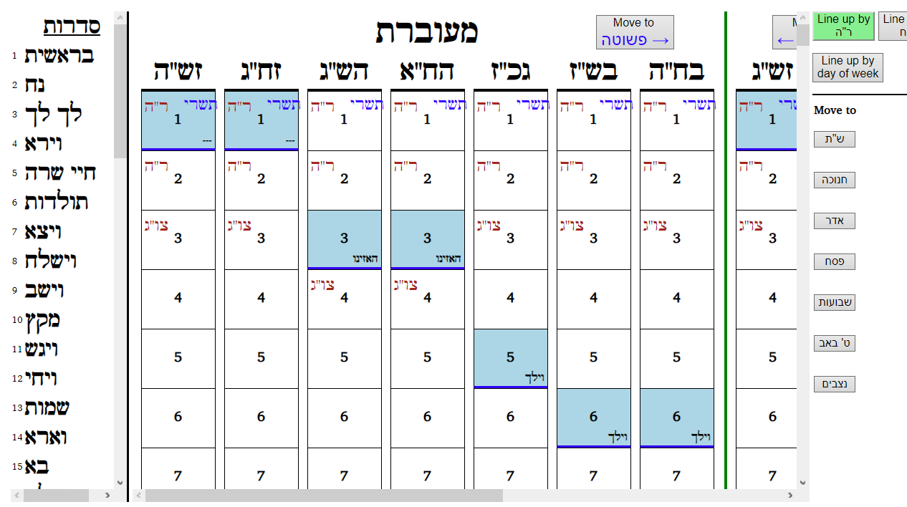

Slide 4
The Keviyus page
The page is based on a chart in the Tur, Orach Chaim, 428.

Slide 6
Parts of the page
The left pane is sidros (parshiyos). Double parshiyos like Vayakhel-Pikudei are colored.
The right pane is calendars, 7 for leap years, 7 for regular years. They run from beginning of the year to the end (and a little beyond), top to bottom, just like in the Tur.
Move from leap years to regular years by scrolling left-right [← → buttons], or clicking the פשוטה/מעוברת button. - Try it near Adar.
The buttons on the right quickly take you to some useful places in the year. The sidros will keep up as well.

Slide 7
Using the Keviyus page
Each of the fourteen vertical calendars starts and ends at Rosh Hashanah (they actually continue till the next Sukkos), and is divided into weeks by the horizontal blue lines.
Between the blue lines are seven days, Sunday → Shabbos (Shabbos has a light blue background).
Click in the Calendars pane and Page-down or -up to move exactly one week.

Slide 8
Using the Keviyus page, cont.
The numbers on each day are the day of the month, 1 → 29 or 30.
Also shown where appropriate: Months (blue), Yomim Tovim (red), and Sidros (black).
Hover over a day to see more information: day of week, day of year, and the number of weeks and days into the year (like, 3 weeks, 2 days). That last will be very helpful when we need to count how many Shabbos Torah readings fall between two dates for a given calendar.
Hover over a “title” (e.g., בש"ז) to see what the different letters mean.

Slide 9
Setting the page format
You can change whether the calendars line up by day of week, or line up so that all Rosh Hashanos start together (default), or that they line up together at Pesach. Each way has its advantages.
It starts with all the Rosh Hashanos lined up. Scroll down and it is easy to see which years are chaseirah, k’sidrah, shleimah: Watch the titles, then scroll down. You’ll see that they are all in synch until you get to the end of Cheshvan and then of Kislev. That’s when you’ll see the longer years get one, then two, days ahead. If you go to the end of the year, you’ll see that they stay that way.

Slide 11
Setting the page format, cont.
The Torah readings are all scattered around this way, though – if you line up by day of the week it’s easier to see them! To get that click the button in the upper right that says, “Line up by day of week”. Now all the calendars have Shabbos and its leinings side by side.
If you click on “Line up by Pesach”, the calendars are lined up by the end of the year. Recall that the entire year after Adar is the same for all the calendars, just shifted by the day of the week. This way the entire end of the year has the calendars lined up from one side to the other.
Only thing is, the regular year (פשוטה), which has one less month than the מעוברת, doesn’t even start for a whole month after the other side starts! Scroll down to see where it begins.

Slide 12
Enjoy using the page!

